Slide 1
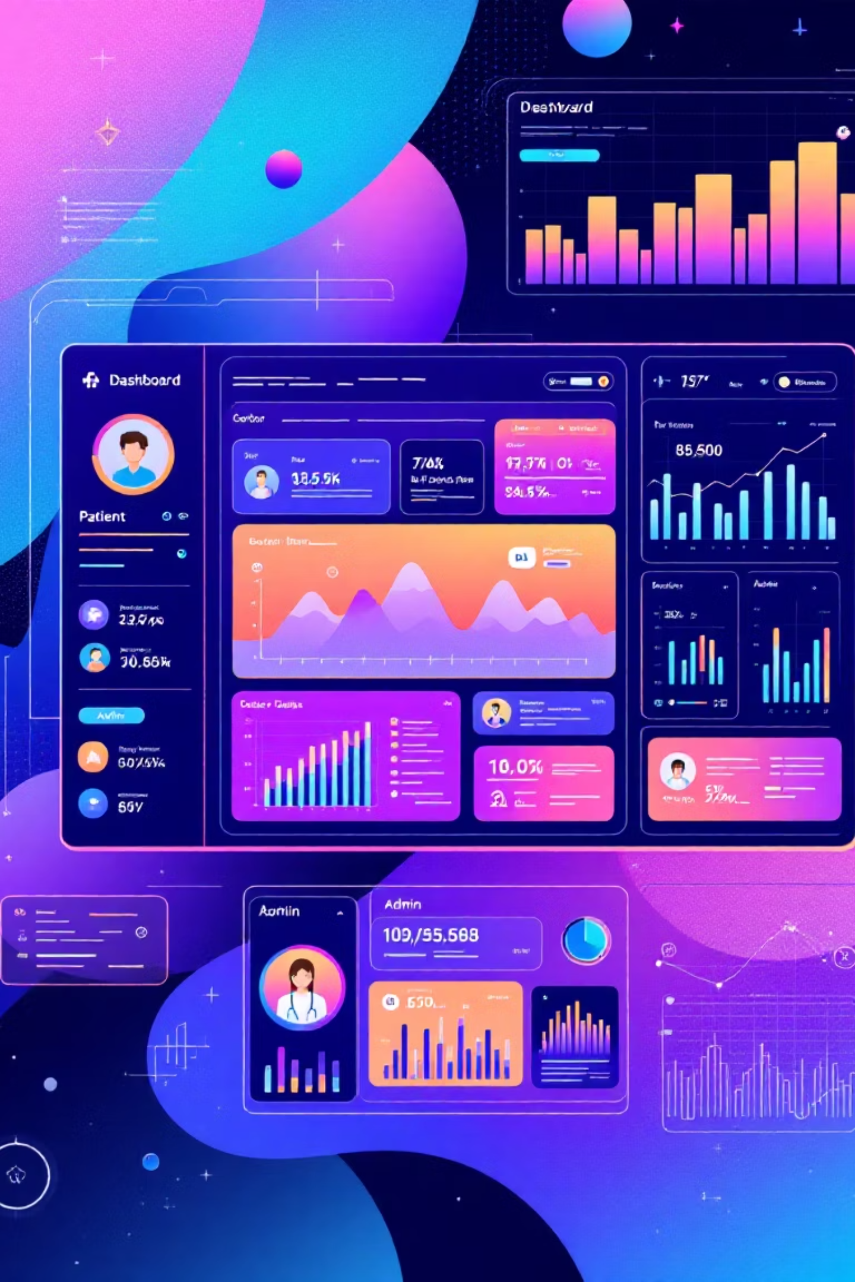
Healthcare Management System Using MEAN Stack
An Innovative solution for modern healthcare management, featuring robust role-based access for patients, doctors, and administrators. This system is designed to streamline operations and enhance user experience.

Slide 2
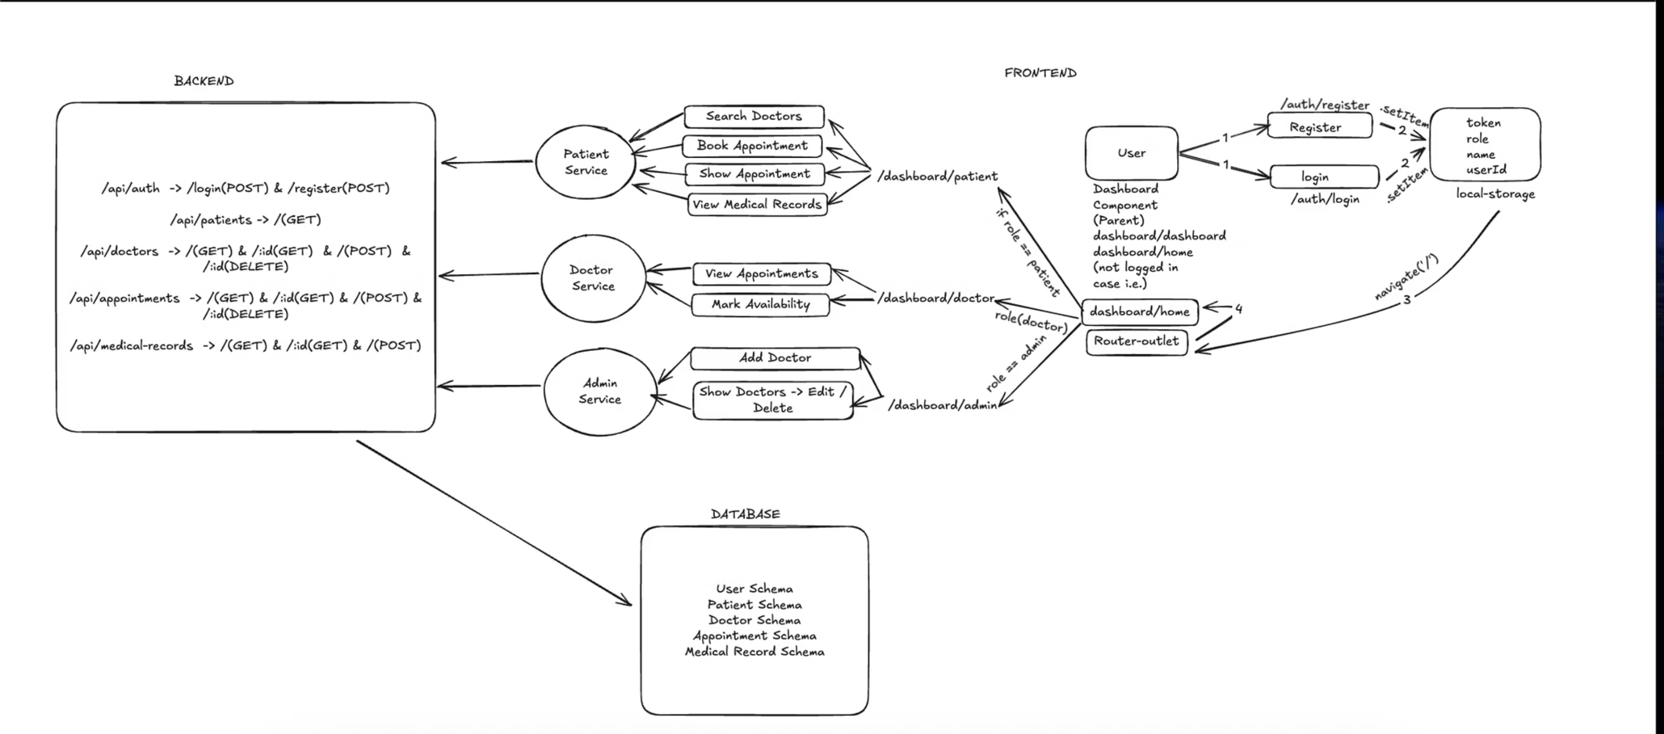
Project Flow Diagram: Visualising User Roles & System Interaction
Explore the intricate dance between users and data within our MEAN stack healthcare management system. This diagram illustrates how patients, doctors, and administrators seamlessly interact, ensuring efficient data flow and secure operations.
Each role is meticulously designed with specific permissions to safeguard sensitive information and optimise functionality.

Slide 3






Key Benefits & Future Vision
Secure & User-Friendly
A secure, scalable, and intuitive healthcare management system tailored precisely to each user role's needs.
Streamlined Operations
Effortless appointment scheduling, rapid patient record access, and comprehensive administrative control for optimal efficiency.
Future Enhancements
Planned integration with telemedicine, AI diagnostics, and advanced analytics for cutting-edge healthcare solutions.
Transforming Workflows
Ready to revolutionise healthcare workflows with modern web technology and robust security protocols, ensuring data integrity.

Slide 4

Why a Role-Based Healthcare System?
In the complex world of healthcare, stringent security and privacy controls are paramount. Our Role-Based Access Control (RBAC) system is engineered to meet these demands.
Data Security: Healthcare data requires the highest level of protection against unauthorised access.
Tailored Access: RBAC ensures that patients, doctors, and administrators only access the information relevant to their specific duties.
Enhanced Compliance: Adherence to regulations like GDPR and HIPAA is significantly improved through defined access privileges.
Operational Efficiency: By streamlining access, RBAC boosts productivity and reduces potential errors.
RBAC isn't just a feature; it's the foundation for a secure, compliant, and highly efficient healthcare management environment.

Slide 5







System Architecture & Technology Stack
Express.js
MongoDB
Robust backend framework handling RESTful APIs and server logic efficiently.
Flexible NoSQL database for secure storage of diverse patient records.
Node.js
Angular
Powerful JavaScript runtime, enabling scalable server-side application development.
Dynamic front-end framework, delivering responsive and intuitive user interfaces.
This MEAN stack foundation ensures a full-stack JavaScript development environment. Role-based authentication intelligently routes users to customised patient, doctor, or admin dashboards, each with appropriate access privileges.

